Slide 1
Ansible - Configuration management tool

Slide 2
Agenda
What is Ansible?
Installing Ansible
Ansible Playbooks
Using ansible for Configuration management tasks

Slide 3
What is Ansible
Idempotency: The Property of an operation where the same results are achieved when the input parameters are unchanged, regardless the number of times it is called.
Convergence: The process of creating a unified state from multiple idempotent actions.
Ansible is an automation engine that is used as configuration management tool, deployment tool, provisioning tool and virtually automate many of infrastructure processes.
Agentless operation!
Ansible uses Python scripting / programs for calling playbook and other code inside Ansible. This means that you need to have Python version 2.5+ installed on the control server and nodes that you want to control.
Ansible Inventory file: (/etc/ansible/hosts)
An inventory file can be created dynamically using python script like ec2.py and similar ones from google cloud etc.

Slide 4
Ansible Architecture
CMDB
Ansible control server
N/W devices – Routers and Switches
Windows
inventory
Modules
APIs
Plugins
Hosts
Unix
ssh / winrm
Playbook
MAC Os

Slide 5
Ansible use SSH for communicating with nodes, thus ssh protocol should be enabled on the nodes and server. The nodes must have python installed on them in order to run the playbook.
The Playbooks are expressed in YAML language (*.yaml extension file)
Some ad-hoc commands that can be fired from the Ansible server.
$ ansible all –m ping
$ ansible webservers –m yum –a “name=httpd state=installed”
$ ansible webservers -a “usr/sbin/reboot”
Ansible has built-in modules that can be used for various operation like package installation, deployment, installing a particular app.
In order to have more structured way to manage your infrastructure we can create and use Ansible Playbooks. Below is a sample playbook that can be used for infra config management.
http://docs.ansible.com/ansible/modules_by_category.html ---- list of module available on Ansible archive.
About ANSIBLE

Slide 6
Installing Ansible
Installing Ansible on Linux variants:
Debian/Ubuntu: The easiest way to install Ansible on a Debian or Ubuntu system is to use the official apt package.
$ sudo apt-add-repository -y ppa:ansible/ansible
$ sudo apt-get update
$ sudo apt-get install -y ansible
Incase there’s an error about Python, run below command.
$ sudo apt-get install python-software-properties
Once installed check version by running below command,
$ ansible –version
Create a file at /etc/ansible/hosts (the default location for Ansible’s inventory file), and add one server to it:
$ sudo mkdir /etc/ansible
$ sudo touch /etc/ansible/hosts
Edit this hosts file with nano, vim, or whatever editor you’d like, but note you’ll need to edit it with sudo as root. Put the following into the file:
[webserver]
webserver1
……

Slide 7
Ansible Lab Setup
Scenario 1
Inventory
Ad-Hoc Commands
Environment
Plabk.yml
Plabk.yml
Scenario 2
Inventory
Vars
Tasks
Templates
Ansible.cfg
Vars
Tasks
Templates
Ansible.cfg
Inventory
Role
Handlers
Plabk.yml
Handlers
Plabk.yml
Scenario 3
playbook
Vars
Tasks
Templates
Vars
Tasks
Templates
Ansible.cfg

Slide 8
Ansible Inventory
Ansible inventory is a collection of server / nodes that we want to control using the Ansible CF tool.
There are two types in this to maintain the inventory,
Static inventory
Dynamic inventory
Static inventory is typically declared in /etc/ansible/hosts file. This location can be altered as per requirement and should be mentioned accordingly in ‘ansible.cgf’ file.
[dbserver]
mysql1.example.com
[webserver]
webserver.example.com
[appserver]
appserver [01:25].example.com
$ ansible –i /etc/ansible/hosts –m ping dbserver - - - - - inventory mentioned in ‘hosts’ under the group ‘dbserver’ are ping using the ‘ping’ module
Incase there are multiple servers inside a group one can only perform action on selected server inside a group by using the ‘- l’ limit switch.
Dynamic inventory is generated / updated using script written in python or shell by querying the AWS remote server environment. AWS provides a python script (ec2.py). Ansible provides plugins (script) for most of the cloud environments, like Google, Azure, AWS, etc.

Slide 9
Managing Variables
Inventory file
Vars folders
Variables can be declared in these files and locations inside Ansible environment. While the data lookup for variable called inside a playbook happens, the priority and preferences for variable data lookup is as per the order,
Variables if declared inside role
Variable if declared in playbook
Variable if declared in group_vars and/or host_vars folders
Variable if declared inside inventory file
[webserver]
192.168.12.11
192.168.12.33
[webserver:vars]
key=value
key=value
group_vars
-- all
-- group_name
host_vars
-- host_name
3
4
Playbook.yml
name
hosts
remote_user
vars:
key1: value
key2: value
tasks:
- name: manage
2
roles
roles
role_name
tasks
main.yml
vars
main.yml
1

Slide 10
Ansible Module
Ansible module are available for almost all types of work that one would want to carry out.
On ansible server these can be listed using command,
$ ansible-doc –l
Also more information can retrieved using command,
$ ansible-doc <module_name>
Module Category
Manage server
Maintain virtual servers
Configure network equipment.
Maintain database and tables
Deploy load balancer configuration.
Example the ‘setup’ module fetch the remote hosts profile information. Thus the setup module actually runs the ‘Ohai’ profiler.

Slide 11
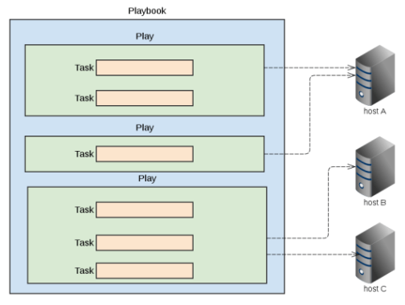
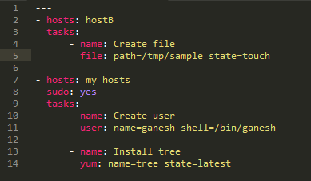
Ansible playbook
The syntax of writing the playbook is very specific. Specially about indentation.
Running a ‘playbook’ from command line is done using below command,
$ ansible-playbook <xyz-playbook.yml.>

Slide 12
Ansible Playbook
---
- hosts: webservers
vars:
http_port: 80
max_clients: 200
remote_user: root
tasks:
- name: ensure apache is at the latest version
yum: name=httpd state=latest
- name: write the apache config file
template: src=/srv/httpd.j2 dest=/etc/httpd.conf
notify:
- restart apache
- name: ensure apache is running (and enable it at boot)
service: name=httpd state=started enabled=yes
handlers:
- name: restart apache
service: name=httpd state=restarted
---
- hosts: testgroup1
remote_user: root
tasks:
- name: ensure apache is at the latest version
apt: name=apache2 state=latest
- name: write the apache config file
template: src=/srv/apache2.j2 dest=/etc/apache2.conf
- hosts: testgroup2
remote_user: root
tasks:
- name: ensure PostgreSQL is at the latest version
apt: name=postgresql state=latest
- name: ensure that postgresql is started
service: name=postgresql state=started
Tasks execution happens in order they are written.
Ansible has built-in module for creating EC2 instance on Amazon cloud. Also available for other types of cloud environments.

Slide 13
Ansible Roles
Ansible roles help to ease the maintenance and troubleshooting of Ansible Playbooks.
Structure of Ansible roles:
A role would typical contain below objects,
files – usually the files that are to be copied to the target servers.
host_vars / group_vars - variable definitions.
meta – dependencies in a role.
templates – files that contain dynamic data.
tasks – mainly actions statements in .yml file.
handlers – to perform dependent action to be performed.

Slide 14
Preparing for Windows connection
The Ansible server should be installed with some of the required Python packages that are required for communicating with Windows machine.
Install below python package one-by-one using the over command line,
$ pip install markupsafe
$ pip install xmltodict
$ pip install pywinrm

Slide 15
Ansible Tower
Web based access to configuration management.
Ansible tower dashboard provides information about,
Number of hosts
Inventories
Failed hosts
Projects, project synch failures
Graphical representation of Job status.
Ansible Tower is available as a evaluation version for a limited period of time. This can be downloaded from Ansible website from three resources, namely.
Download package as per your Linux / Unix variant.
Launch Ansible Tower on Vagrant
Launch Tower in Amazon EC2.

Slide 16
Thank You
Notes:
Audio:
Thank you for attending the course.
16

